Slide 1
Hello, How are you today?
I’m fine thanky & you?
Hi, there. I’m 김성현

Slide 2
Hello, How are you today?
I’m fine thanky & you?

Slide 3
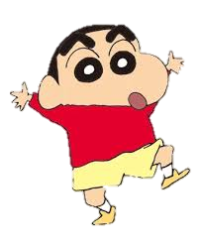
Vertical_1
우리 FISA 파이팅~!
Vertical_2
Inversion
Shinjjang
Rotation

